Slide 1
Lecture 18
18.2 Epilogue!
©Luís M. A. Bettencourt 2024
Notes:
Last module ! Just a few final words to round us up.

Slide 2
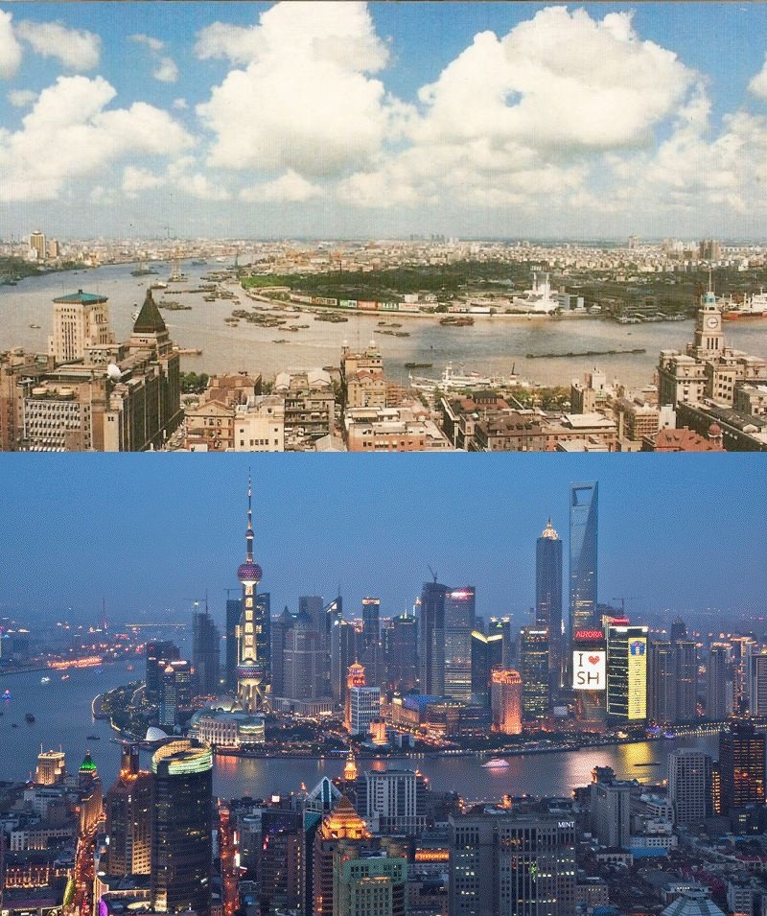
1987
Shanghai
2012
credit: telegraph/reuters/jesus diaz
Notes:
We have seen the miraculous transformative power of cities in human societies. Development has never happened without cities.

Slide 3
Bringing it all together
microscopic
individual, local environments
Life-Course Theory (life path)
Individual budget, growth rates, mechanics of inequality
Complementarities, Diversity and Inequality
Neighborhoods, Social Identity and Segregation
Spatial equilibrium and the Network Structure of Cities
Growth rates, Flows and the Urban System
Information, Collective Agency and Systemic Change
macroscopic
whole cities and nations
Notes:
And we have gone over many topics about cities, at different scales, articulating how different dynamics can happen at predominantly different scales but are interconnected.

Slide 4
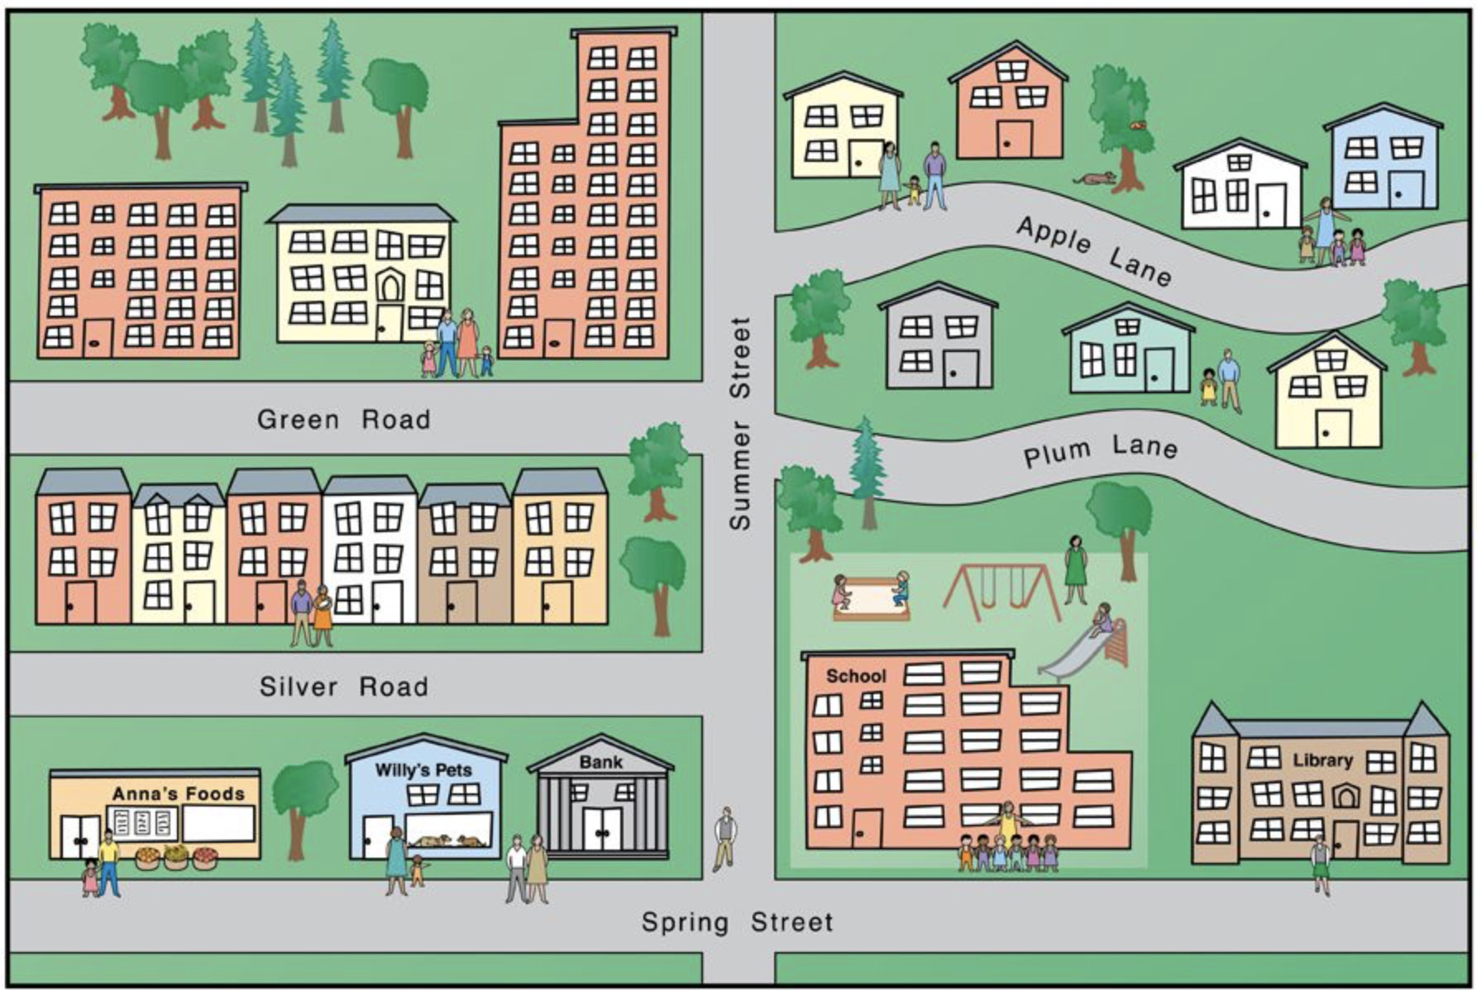
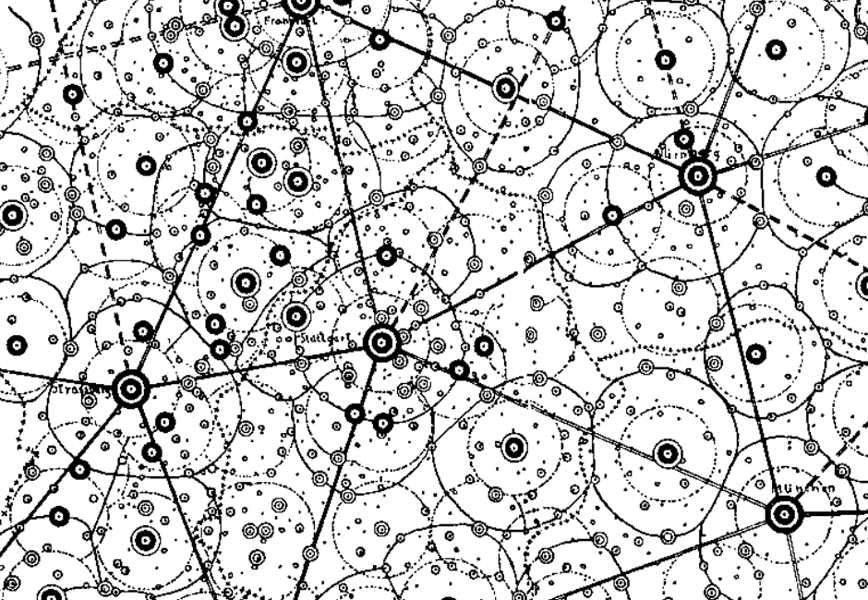
Scale
Integration
Mechanism
cognition
life-course
human development
seeds of economic growth
$${10}^{9}$$
Individual
livability
safety
schools
knowledge
billions
Neighborhood
neighborhood effects
cumulative (dis)advantage
$${10}^{6}$$
selection
segregation
mixing
contagion
millions
scaling and agglomeration
social + physical networks
economy, information, land uses
$${10}^{3}$$
City
thousands
migration
trade
knowledge diffusion
laws of geography
gravity law, Zipf’s law
urban hierarchy
Urban Systems
Urban Science: Integrating scales + disciplines
Notes:
This can also be expressed by this diagram, that we discussed before. All these phenomena are part of cities, and only make sense (scientifically) when we connect them into the same complex system.

Slide 5
Provided that some groups on earth continue either muddling or revolutionizing themselves into periods of economic development, we can be absolutely sure of a few things about future cities:
The cities will not be smaller, simpler or more specialized as cities of today.
Rather, they will be more intricate, comprehensive, diversified and larger than today’s and will have even more complicated jumbles of old and new things than ours do.
Jane Jacobs
The Economy of Cities, 1980
Notes:
We finish with Jane Jacobs and her prediction for cities of the future.

Slide 6
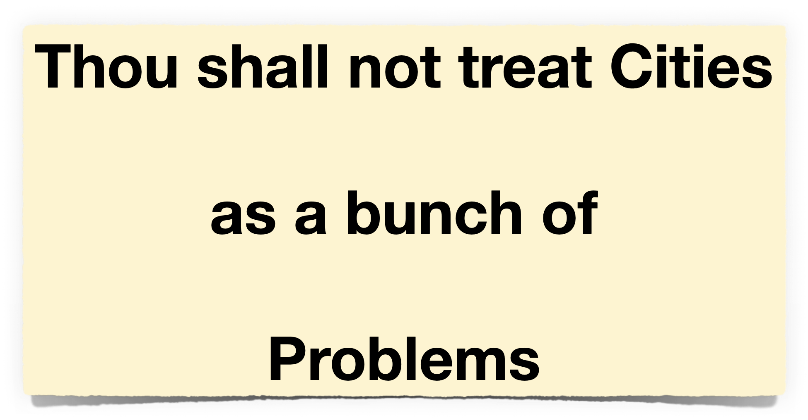
They are the solution to our most fundamental challenge of being creative and prosperous in any society
Notes:
And remember the “first commandment”, do wonder at their diversity, innovation and transformative power, which is there in all of us but only becomes manifested as we come together in society.

Slide 7
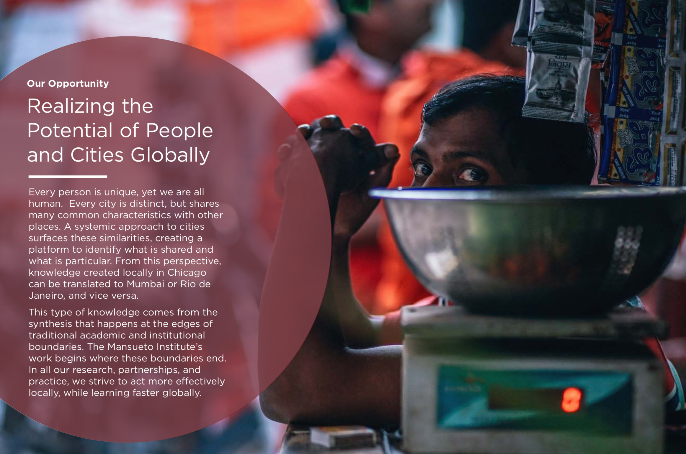
https://urban-science-lab.org
Stay connected !
Notes:
That’s what is all about, letting this potential bloom.

Slide 8
Thank You !

